Slide 1
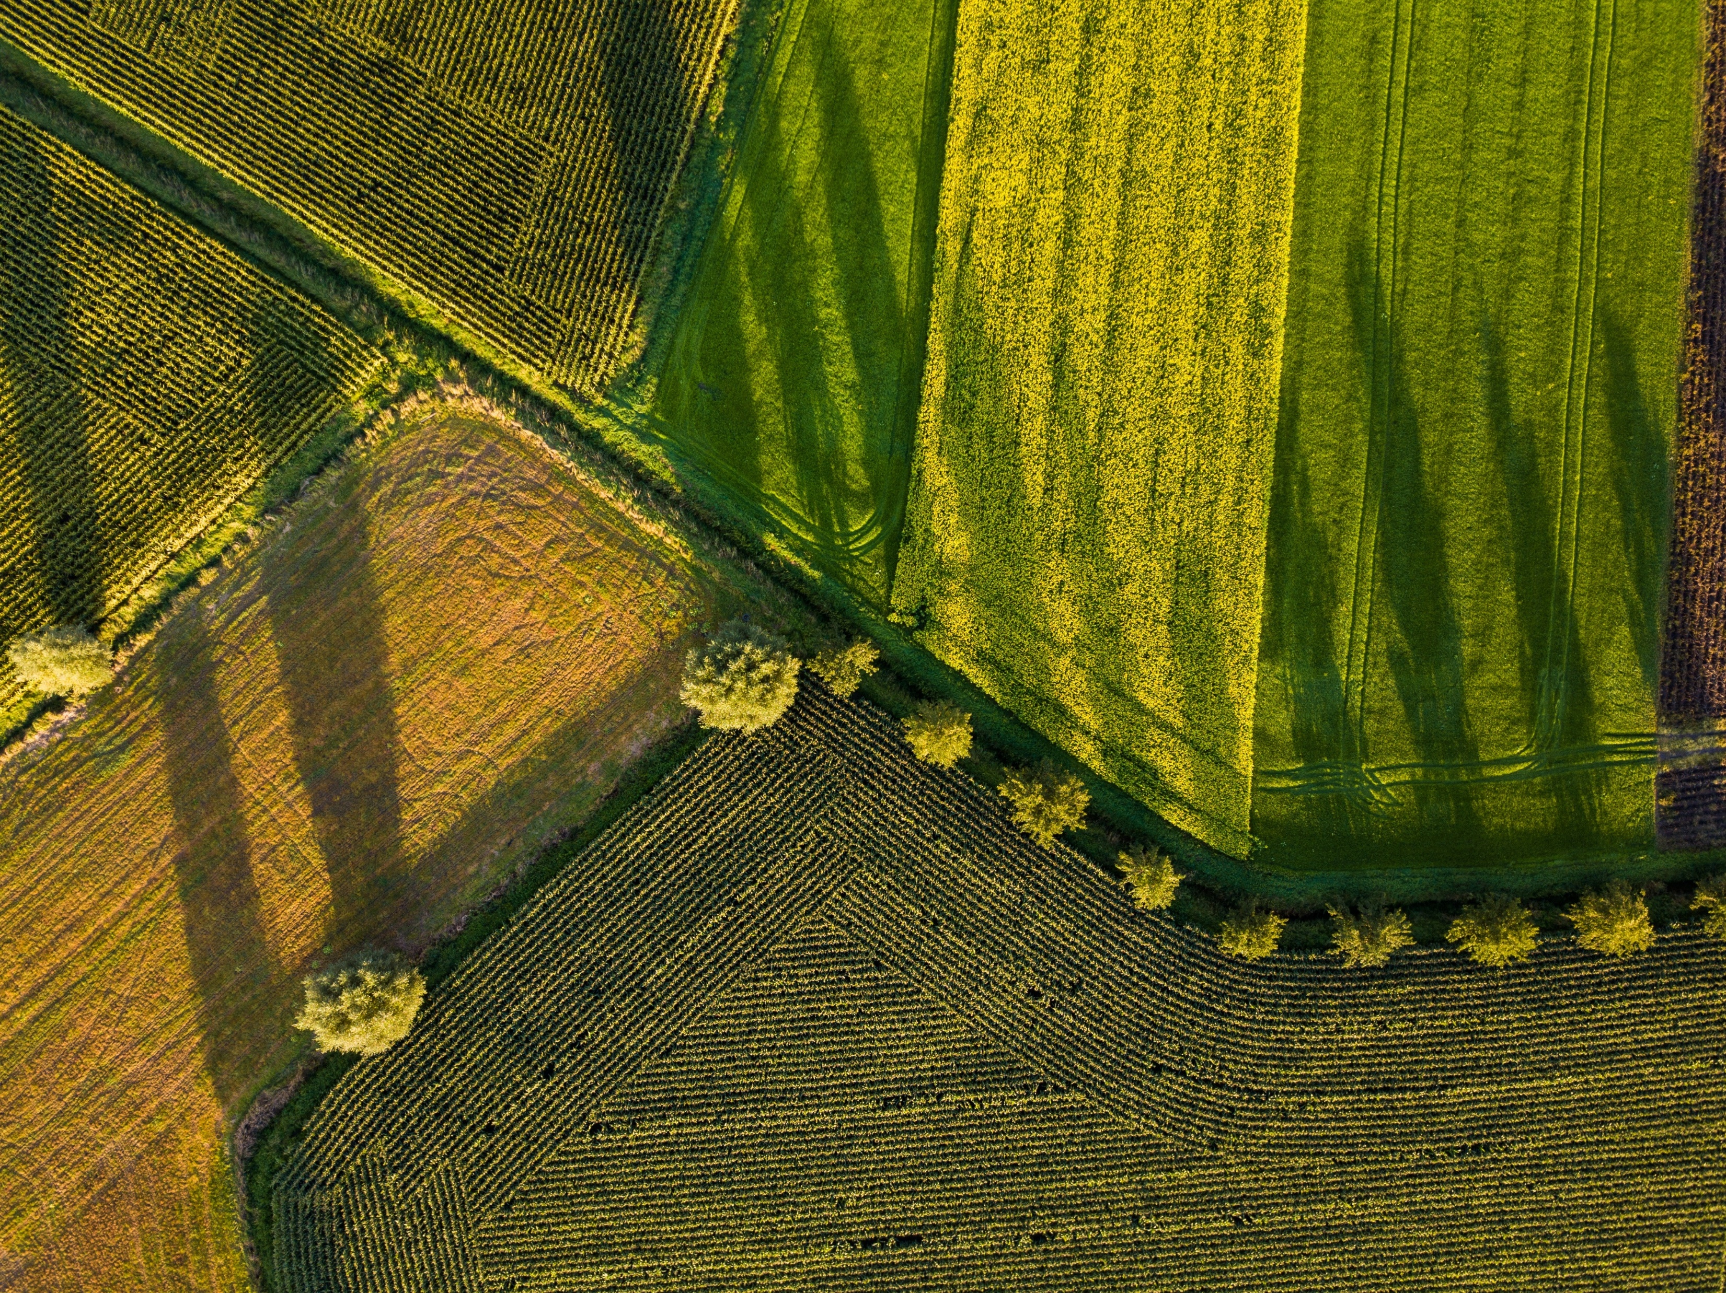

Buhler Group Challenge
THE REAL COST OF FOOD
JABBERWOCKY TEAM

Slide 2

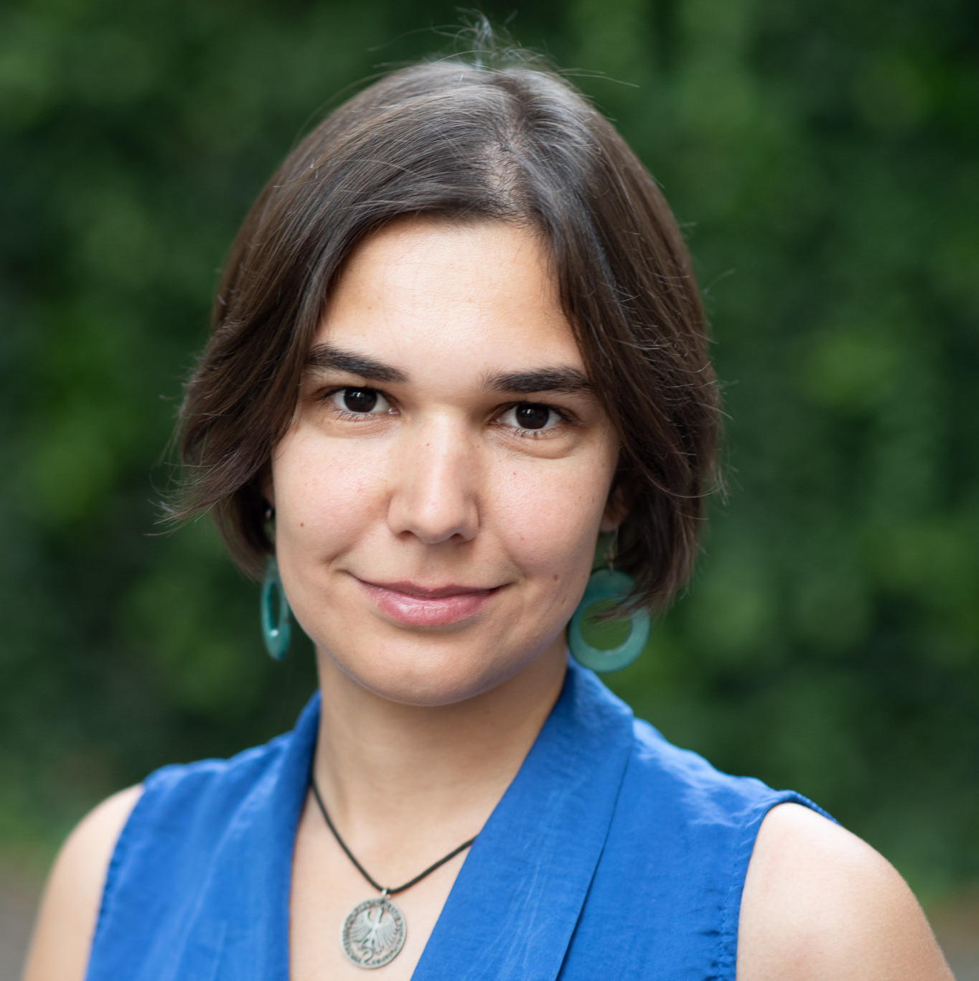
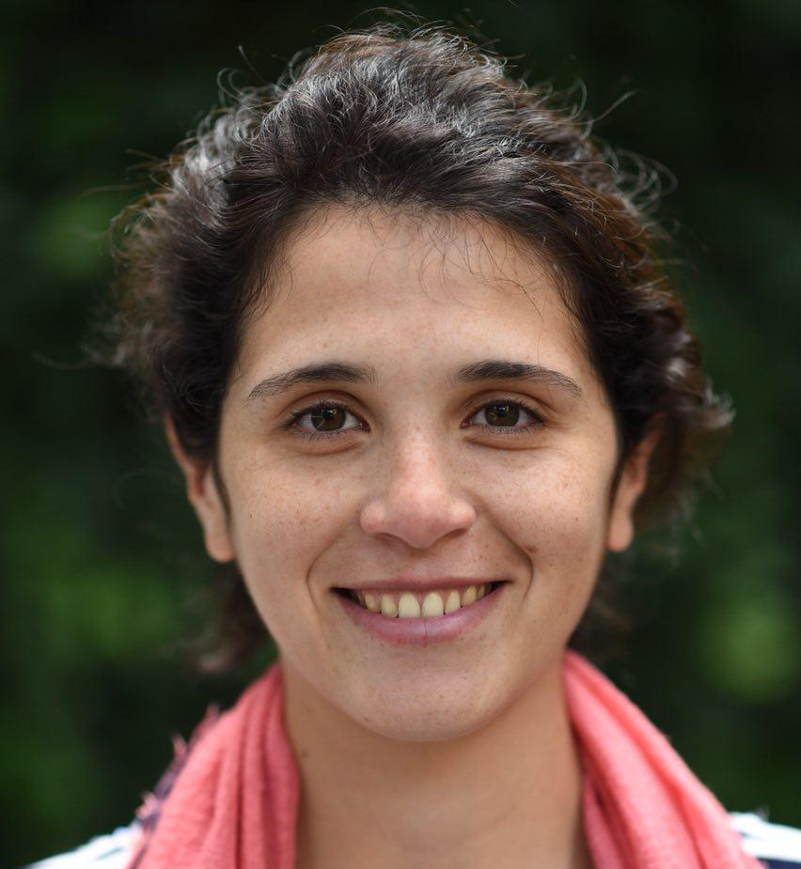
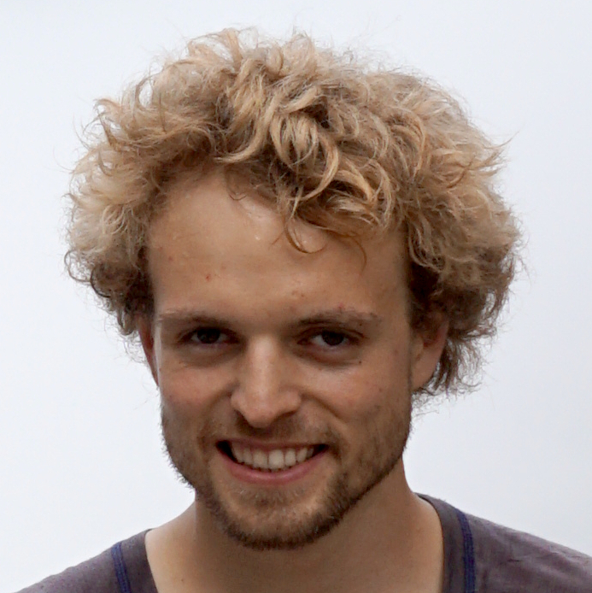
Sebastian
Mariana
Betiana
Gregor

Slide 3
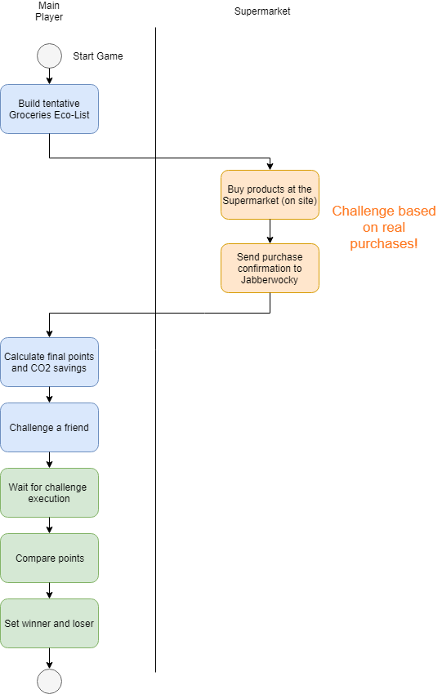
Process Overview

